Slide 1
INT8 model code 변환
Sunghyun Lee, Suhak Lee
Department of Computer Engineering

Slide 2
Convolution flow
scale1
scale2
CONV 1
CONV1 output
CONV 2 input
CONV 2
M = scale1/scale2
(CONV 1 output * scale1) / scale2 = CONV 1 output * M
= CONV 2 input
dequantize
quantize again
Dequantize the conv1 output by multiplying it by scale 1, and then quantize again it by dividing it by scale 2.

Slide 3
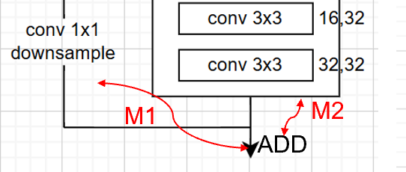
Downsample
conv1x1 downsample
conv3x3 main
output 1 scale1
output 2 scale2
X M1
X M2
input 1 of Elementwise add (scale3)
input 2 of Elementwise add (scale3)
Elementwise add : input1 + input2 (scale3)

Slide 4
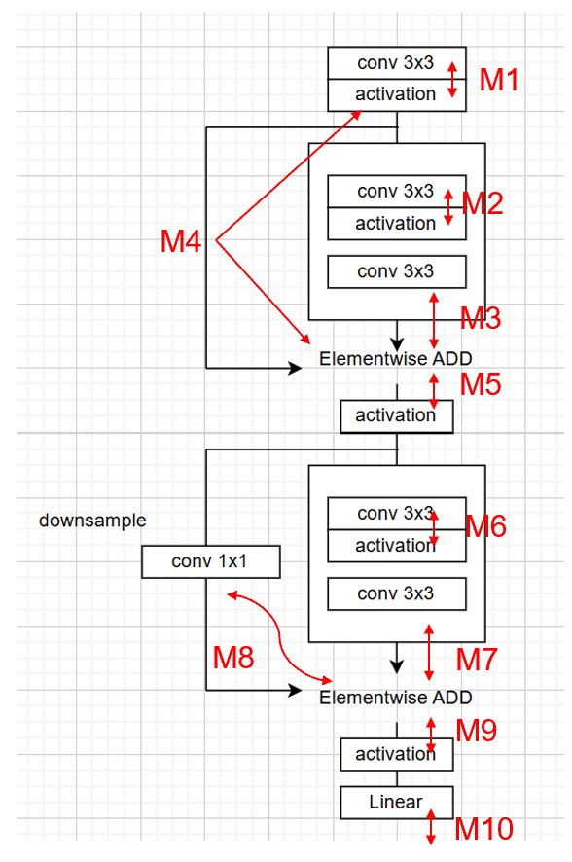
Shortcut C code
Case 1: Identity Shortcut
inA (main path): Already based on add_scale.
inB (identity): Needs to be converted from act_scale basis to add_scale.
After addition: Conversion from add_scale to act_scale is required.
Case 2: Downsample Shortcut
inA (main path): Based on add_scale.
inB (downsample): Based on add_scale.
After addition: Conversion from add_scale to act_scale is required.
Case 1
Case 2

Slide 5
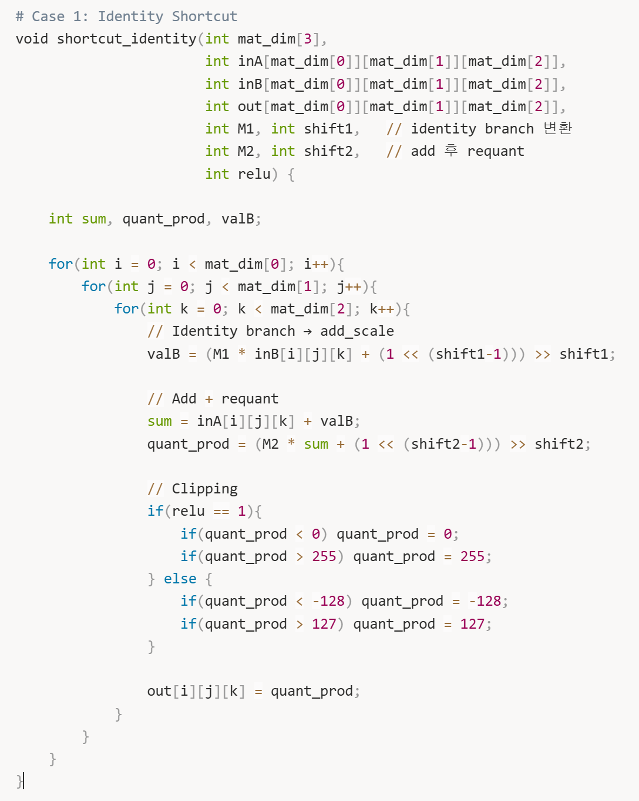
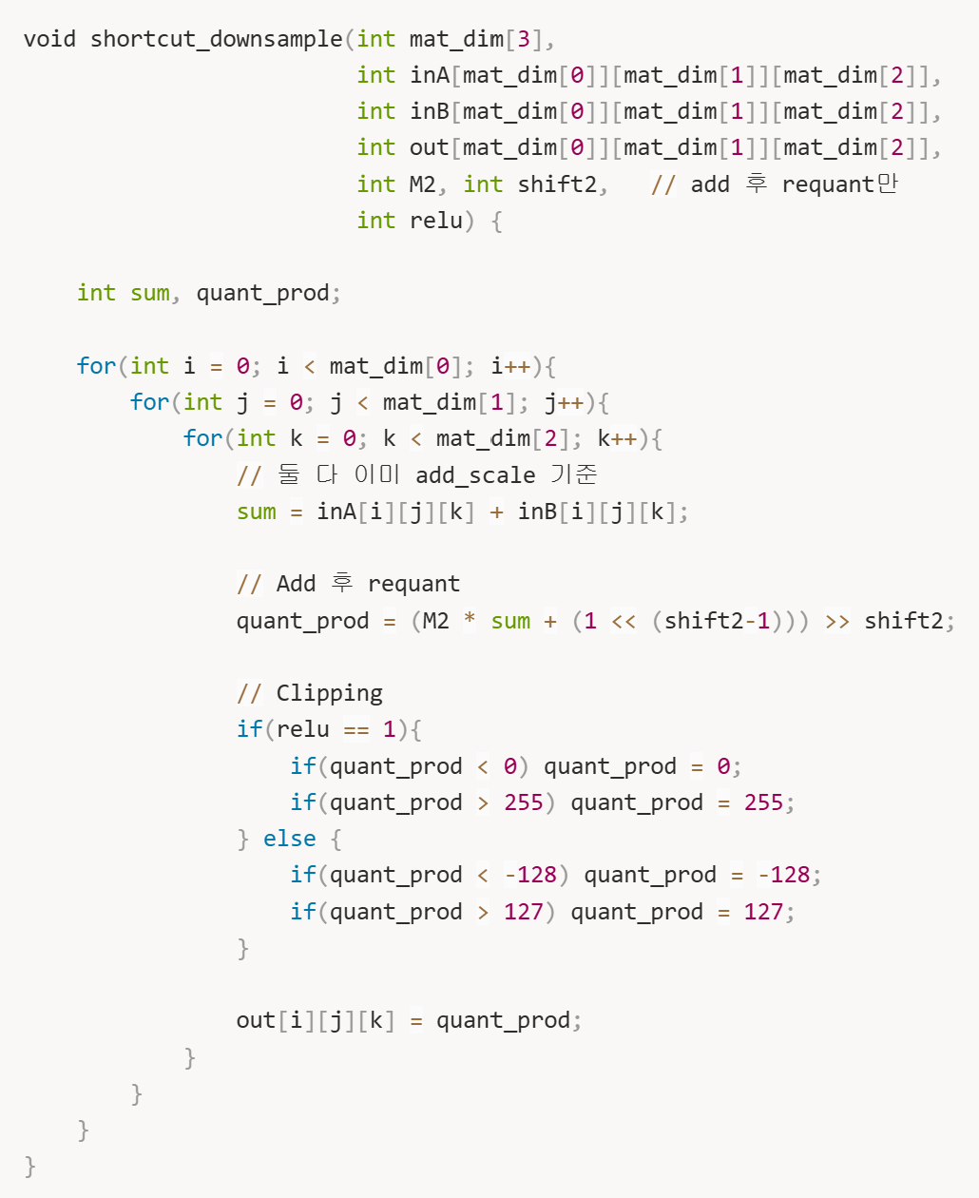
Shortcut C code

Slide 6
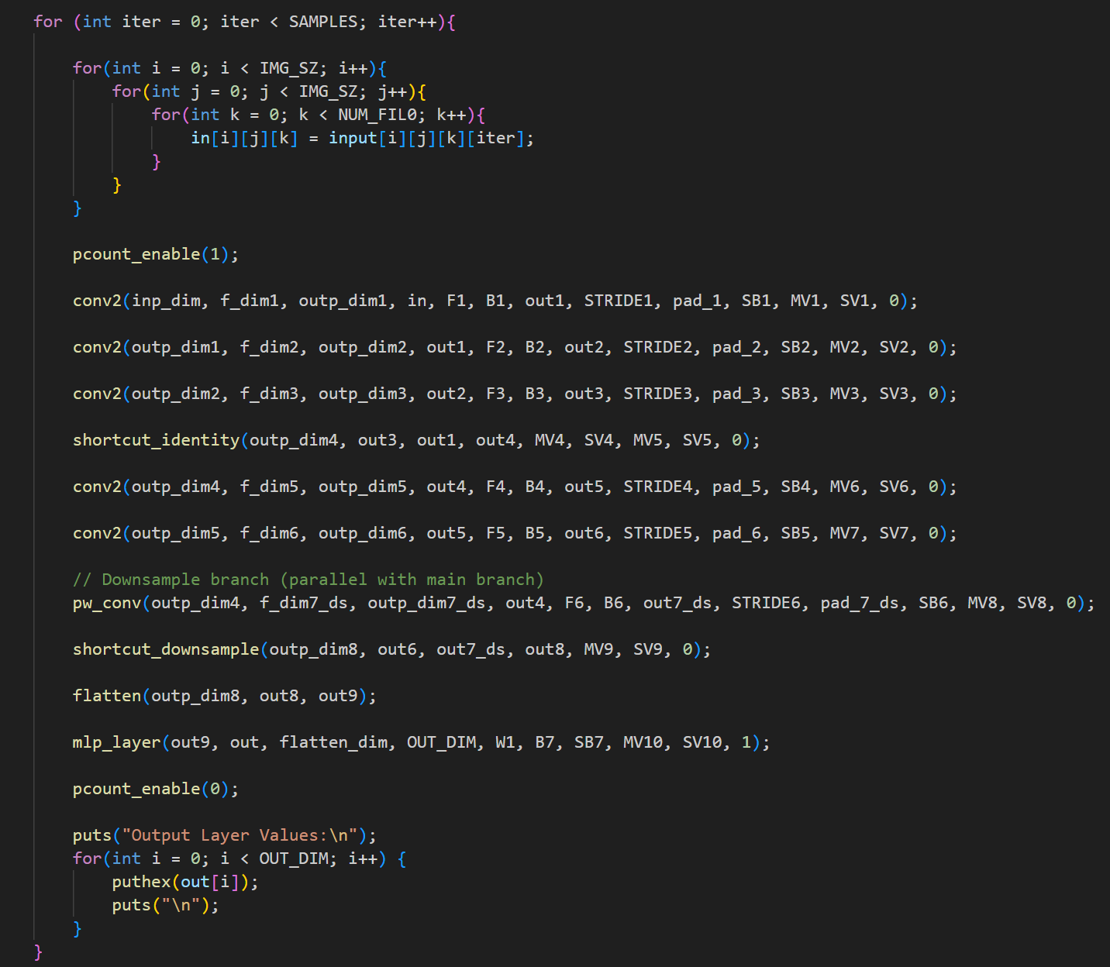
Generate C code

Slide 7
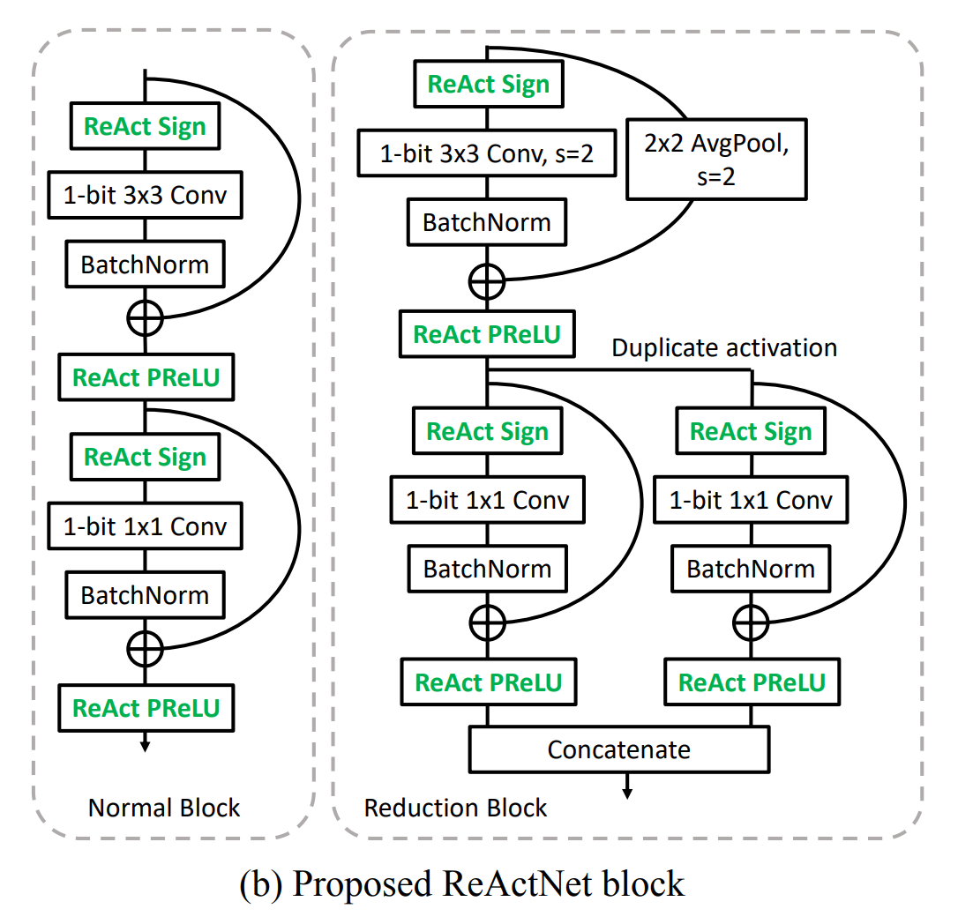
Reactnet
Convert the ReActNet model for C language inference
1. Make C code function like learnable bias, new elementwise add, concat
2. Extract parameter and save into header file
3. Generate C code
The ReActNet model is not working with my existing setup

